Slide 1
Making a Stack Using Linked List
COMPSCI 3SH3 Tutorial 2
TA: Rohan Patel (pater58@mcmaster.ca)

Slide 2
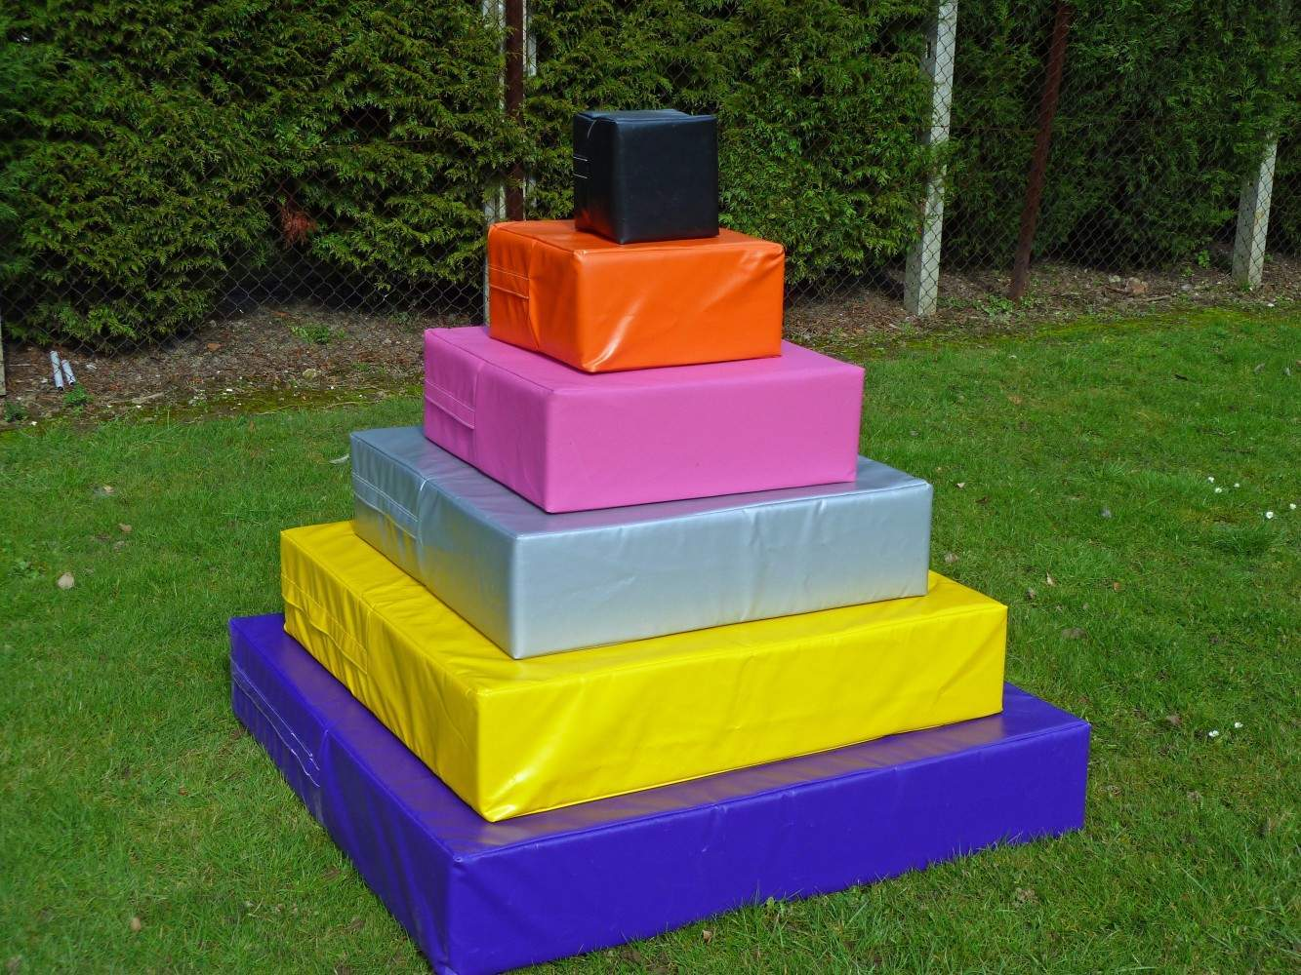
Stack
A stack is a data structure that provides temporary storage of data in such a way that the element stored last will be retrieved first.
This method is also called LIFO – Last In First Out.
EXAMPLE: In real life we can think of stack as a stack of copies, stack of plates etc. The first copy put in the stack is the last one to be removed. Similarly last copy to put in the stack is the first one to be removed.

Slide 3
Stack Operations
A stack is a linear data structure.
It is controlled by two operations: push and pop. Both the operations take place from one end of the stack, usually called top. Top points to the current top position of the stack
Push: Adds an item in the stack. If the stack is full, then it is said to be an Overflow condition.
Pop: Removes an item from the stack. The items are popped in the reversed order in which they are pushed. If the stack is empty, then it is said to be an Underflow condition.
Peek or Top: Returns top element of stack.
isEmpty: Returns true if stack is empty, else false.

Slide 4
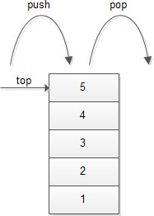
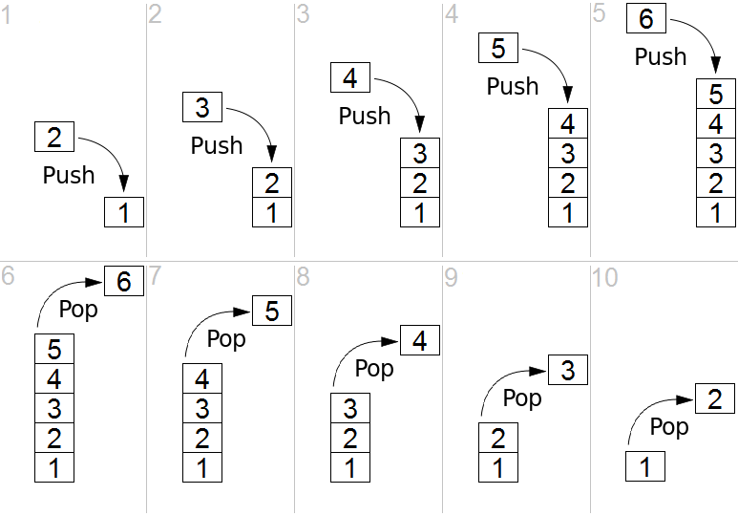
Stack Representation

Slide 5
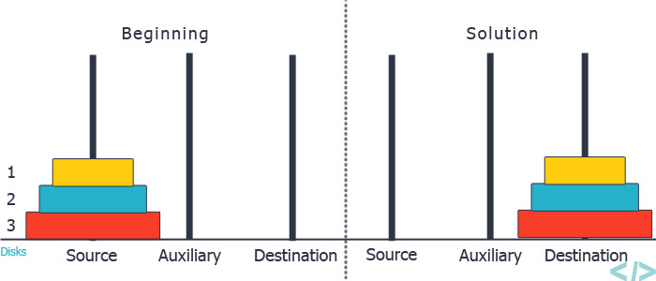
Classic Problem: Towers Of Hanoi

Slide 6
Implementation of Stack
As an Array
As an Linked List

Slide 7
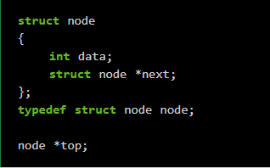
Implementation of Stack Using Linked List Step 1: Create Linked List
typedef struct node node – In this line of code, we are just representing struct node with node by using typedef.

Slide 8
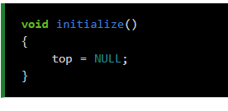
Step 2: Initialize Stack
This will be done by making the ‘top’ equal to NULL because at this point of time our stack doesn’t contain any element.

Slide 9
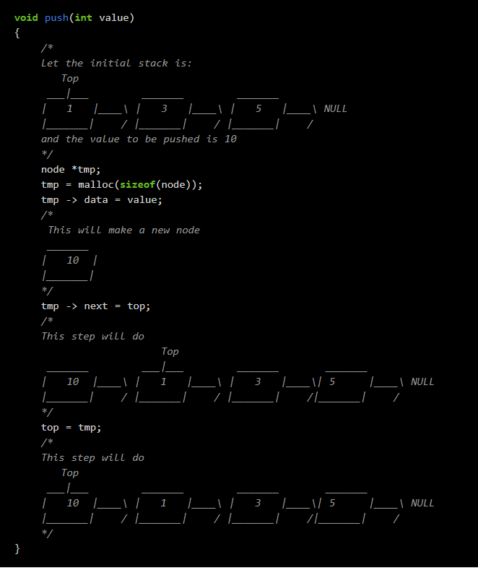
Step 3: Push
Notes:
The steps for push operation are:
Make a new node.
Give the ‘data’ of the new node its value.
Point the ‘next’ of the new node to the top of the stack.
Make the ‘top’ pointer point to this new node.
Read the comments in the code for better understanding.
The first step is to make a new node and we are doing the same by node *tmp tmp = malloc(sizeof(node))
The second step is to give ‘data’ of this new node its value and this we are doing with tmp -> data = value.
The third step is to point the ‘next’ of the new node to the top of the stack and this is done in the next line – tmp -> next = top.
The last step is to make the ‘top’ pointer point to this new node – top = tmp

Slide 10
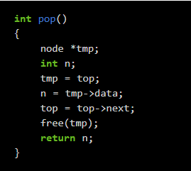
Step 4: POP
pop operations are:
Make a temporary node.
Point this temporary node to the top of the stack
Store the value of ‘data’ of this temporary node in a variable.
Point the ‘top’ pointer to the node next to the current top node.
Delete the temporary node using the ‘free’ function.
Return the value stored in step 3.
Notes:
In pop operation, we delete the topmost node and returns its value. In order to do so, we need to make the ‘top’ pointer point to the node next to the topmost node but this will led the current topmost node inaccessible. So, we will first make a temporary pointer to the current top node and delete it using the ‘free’ function later. The steps for the pop operations are:
Make a temporary node.
Point this temporary node to the top of the stack
Store the value of ‘data’ of this temporary node in a variable.
Point the ‘top’ pointer to the node next to the current top node.
Delete the temporary node using the ‘free’ function.
Return the value stored in step 3.
The code is very simple and just follows the steps mentioned above.
node *tmp – Step 1
tmp = top – Step 2
n = tmp->data – Step 3
top = top->next – Step 4
free(tmp) – Step 5
return n – Step 6

Slide 11
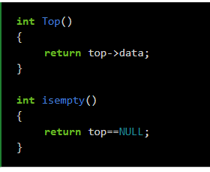
Step 4: Create other operations
Other operations are:
Top: function is just returning the data at the top of the stack.
isempty: is to check if the stack is empty or not and this can be done by checking the ‘top’ pointer. If the ‘top’ pointer is null then the stack is empty otherwise not and this is what we are doing in the ‘isempty’ function.
Notes:
In pop operation, we delete the topmost node and returns its value. In order to do so, we need to make the ‘top’ pointer point to the node next to the topmost node but this will led the current topmost node inaccessible. So, we will first make a temporary pointer to the current top node and delete it using the ‘free’ function later. The steps for the pop operations are:
Make a temporary node.
Point this temporary node to the top of the stack
Store the value of ‘data’ of this temporary node in a variable.
Point the ‘top’ pointer to the node next to the current top node.
Delete the temporary node using the ‘free’ function.
Return the value stored in step 3.
The code is very simple and just follows the steps mentioned above.
node *tmp – Step 1
tmp = top – Step 2
n = tmp->data – Step 3
top = top->next – Step 4
free(tmp) – Step 5
return n – Step 6

